Slide 1


Disneyland Review Analysis
D214 - CAPSTONE
David Fabian
WGU
M.S. Data Analytics

Slide 2
AGENDA
  Research Question
  Goals
  Dataset Overview/Collection
  Data Extraction and Preparation
  Exploratory Analysis
  Model Choice and Building
  Model Summary and Analysis
  Future Steps and Recommendations

Slide 3
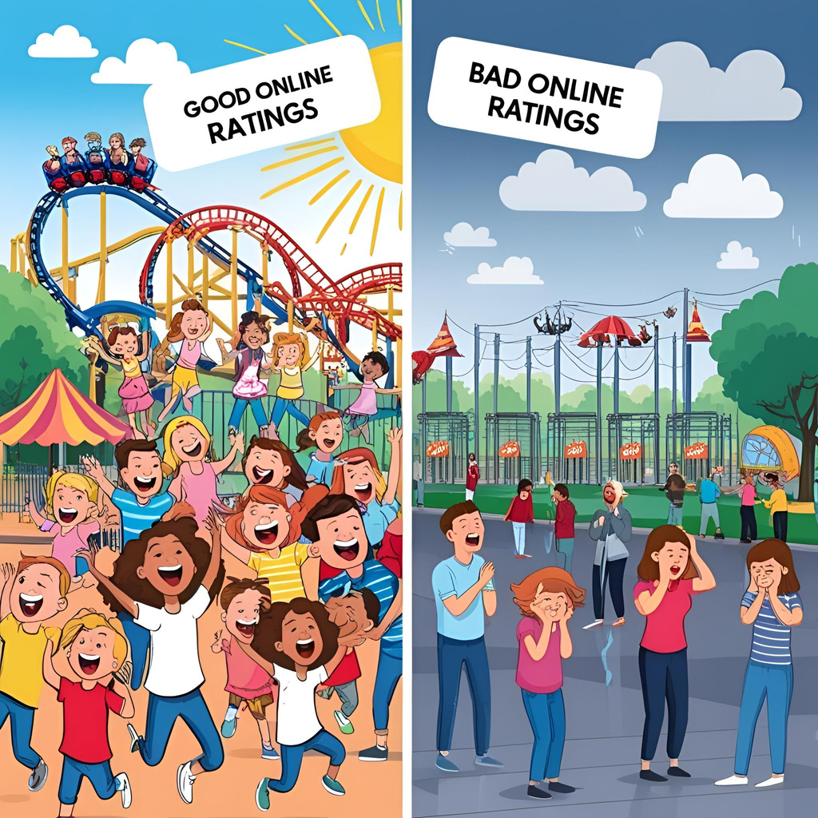
RESEARCH QUESTION
How accurately can a neural network predict Disneyland California ratings (1-5) based on customer sentiment?

Slide 4

GOALS
  Create a model that can accurately predict ratings based off parkgoer sentiment.
  Null Hypothesis:
    The chosen neural network does not achieve accuracy of 80% or more.
  Alternate Hypothesis:
    The chosen neural network achieves accuracy of 80% or higher.
  Business Benefits:
    Flagging system
    Increase visitor return rate
    Find areas to market and improve

Slide 5


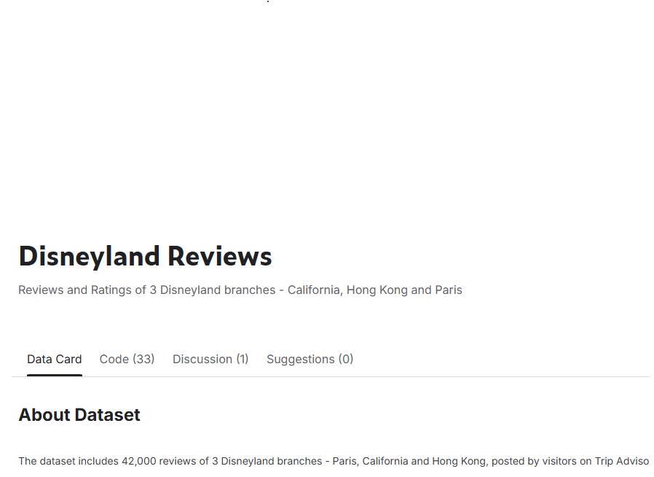
DATASET OVERVIEW/COLLECTION
  Disneyland Reviews Dataset
    Kaggle.com
    TripAdvisor
  Features
    Review_ID
    Rating 1-5
    Reviewer_Location
    Review_Text
    Disneyland_Branch
      Paris
      Hong Kong
      California

Slide 6
DATASET OVERVIEW/COLLECTION CONT.
  Advantages
    Large Dataset
    Web scraping process was done by the author.
  Disadvantages
    Limiting to only Tripadvisor source and not including reviews from Google and Yelp.

Slide 7
DATA EXTRACTION AND PREPARATION
  Tools:
    Pandas
    Numpy
    Re
      Regular Expression
  Matplotlib
  NLTK
    Natural Language Toolkit
  Tensorflow
  Keras

Slide 8


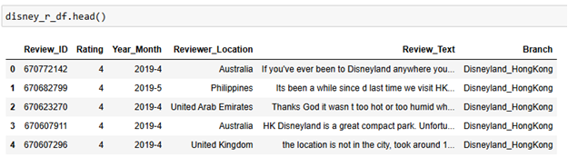
DATA EXTRACTION AND PREPARATION CONT.

Slide 9
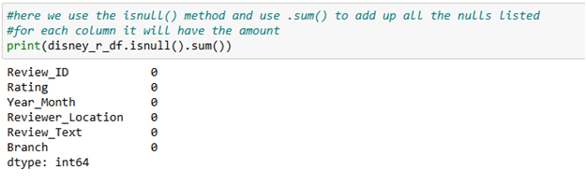
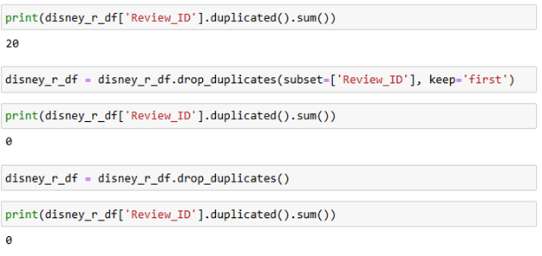
DATA EXTRACTION AND PREPARATION CONT.
HANDLING NULLS
HANDLING DUPLICATES

Slide 10
DATA EXTRACTION AND PREPARATION CONT.
SPECIFY TO CALIFORNIA
CONTINUE CODE IN WORKBOOK
  REMOVE NON-ALPHANUMERIC CHARACTERS
  TOKENIZATION
  LEMMATIZATION
  PADDING

Slide 11
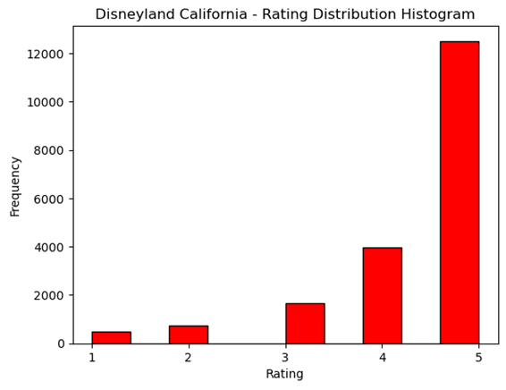

EXPLORATORY ANALYSIS CONT.

Slide 12
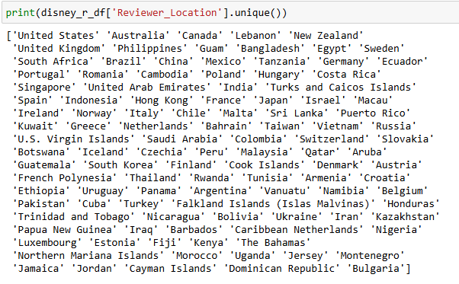



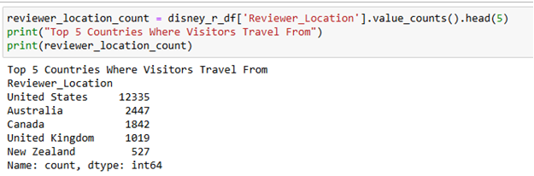



EXPLORATORY ANALYSIS CONT.

Slide 13
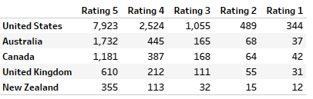
EXPLORATORY ANALYSIS CONT.

Slide 14
MODEL CHOICE
  Bidirectional Long Short Term Model aka BiLSTM
    A form of LSTM model which takes input in both directions.
    Forward and backward directions enable model to learn past and future meanings.
    Regular LSTM
      Left to right sequence processing.
      Learns meaning based on past words.
  Pros:
    Better understanding because of past and future data.
    Better accuracy
  Cons
    Consumes a lot of computational resources.
    Takes a long time to train.

Slide 15
MODEL CREATION
  Split data into a 70/30 split for training and testing
    Make sure there is sufficient data for model to train on.
    30% is adequate.
  Subtract 1 from y_test and y_train for sparse categorical cross entropy
  Create Model Layers
  Initialize optimizer
  Compile model with class weights, early stopping, and learning rate schedule

Slide 16
MODEL LAYERS
  Embedding Layer
    Indices to dense vectors
    Input_dim set to vocabulary size for total number of unique tokens.
    200 dimensional vector
    Input length set to max length for the fixed length for all sequences.
  Bidirectional LSTM Layer
    Wrap the LSTM with Bidirectional for dependencies in both directions.
    Return_sequences set to true to output entire sequence for each step.
    Recurrent dropout set to 0.1 to regularize the model.
    Kernel Regularizer set to l2(0.002) for overfitting.

Slide 17
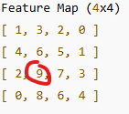
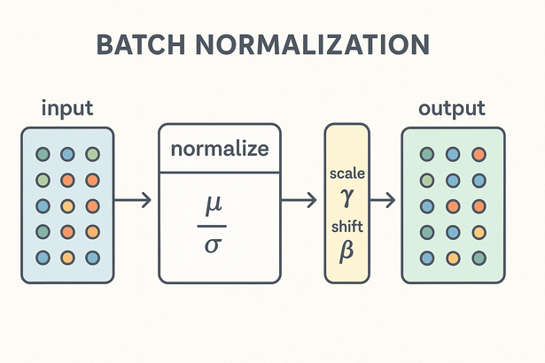
MODEL LAYERS CONT.
  Global Max Pooling
    Reduces size of data.
    Keep most important information.
    Combat overfitting.
  Dropout Layer
    Set to 30%.
    Drops 30% of neurons to deal with overfitting.
  Batch Normalization
    Prevent vanishing gradients.
    Train faster.
    Mild dropout.
    Keeps mean output closer to zero and standard deviation closer to one.

Slide 18
MODEL LAYERS CONT.
  Dense Layer
    64 units and ReLU activation function.
    Learning non-linear patterns.
    Add L2 regularization for overfitting.
  Leaky ReLU
    Added after the dense layer with ReLU activation.
    Lets a small, non zero value through when input is negative.
    Normal ReLU turns all negative values to zero which can kill learning in some neurons.

Slide 19
MODEL LAYERS CONT.
  Dropout Layer
    Another dropout layer set to 30%
  Output Layer
    Multi-class
    Set to 5 classes that correspond to 1-5 ratings.
    Softmax to convert to class probabilties

Slide 20
MODEL COMPUTATION AND FITTING
  Optimizer
    Manually set Adam optimizer with learning rate of 0.0005.
    Sparse_categorical_crossentropy since we have ratings with integer values. Use for multiclass classification.
    Accuracy metric.
  Callbacks
    Monitor is set to validation loss
    Patience set to 3.
    Restore best weights.
  LR Schedule
    ReduceLROnPlateau to adjust learning rate when there is no improvement.

Slide 21
MODEL COMPUTATION AND FITTING CONT.
  Class Weights
    Used to assist with the class imbalance that was shown in the charts.
    Make sure classes with less volume are not ignored during training.
  Fitting Model
    Train
    15 epochs
    Apply the class weights, learning rate adjustments, and early stopping.

Slide 22
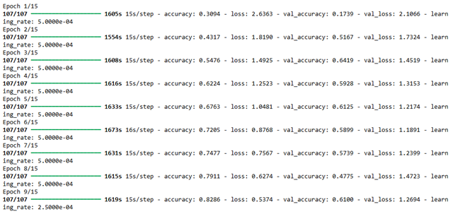
MODEL COMPUTATION AND FITTING CONT.

Slide 23
EPOCH SUMMARY
  Epoch 1
    Beginning of the learning process. There is high loss and low accuracy since it just started.
    Training Accuracy: 0.3094
    Training Loss: 2.6363
    Validation Accuracy: 0.1739
    Validation Loss: 2.1066
  Epoch 2
    There is a big improvement in the validation accuracy which means the model learned patterns.
    Training Accuracy: 0.4317
    Training Loss: 1.8190
    Validation Accuracy: 0.5167
    Validation Loss: 1.7324

Slide 24
EPOCH SUMMARY CONT.
  Epoch 3
    Here in epoch 3, we get the best validation accuracy which means the model was generalizing well.
    Training Accuracy: 0.5476
    Training Loss: 1.4925
    Validation Accuracy: 0.6419
    Validation Loss: 1.4519
  Epoch 4
    Small drop in the validation accuracy but model was still learning.
    Training Accuracy: 0.6224
    Training Loss: 1.2523
    Validation Accuracy: 0.5928
    Validation Loss: 1.3153

Slide 25
EPOCH SUMMARY CONT.
  Epoch 5
    Epoch 5 has the best validation loss. Appears to have smooth training at this point.
    Training Accuracy: 0.6763
    Training Loss: 1.0481
    Validation Accuracy: 0.6125
    Validation Loss: 1.2174
  Epoch 6
    Training Accuracy: 0.7205
    Training Loss: 0.8768
    Validation Accuracy: 0.5899
    Validation Loss: 1.1891

Slide 26
EPOCH SUMMARY CONT.
  Epoch 7
    Signs of overfitting since we see the validation loss increasing.
    Training Accuracy: 0.7477
    Training Loss: 0.7567
    Validation Accuracy: 0.5739
    Validation Loss: 1.2399
  Epoch 8
    Validation performance drops which indicates overfitting.
    Training Accuracy: 0.7911
    Training Loss: 0.6274
    Validation Accuracy: 0.4775
    Validation Loss: 1.4723

Slide 27
EPOCH SUMMARY CONT.
  Epoch 9
    From this point the training is improving and the validation recovers a bit.
    Training Accuracy: 0.8286
    Training Loss: 0.5374
    Validation Accuracy: 0.6100
    Validation Loss: 1.2694

Slide 28
EPOCH SUMMARY CONT.
  Key Points
    The model took a long time for each epoch—around 26 minutes each time, which can be bad if stakeholders' performance needs to be improved.
    In Epoch 3, we have the best accuracy at 64.19%.
    Epoch 5 is the best epoch for validation loss at 1.2174.
    We see overfitting after epoch five when validation starts to fluctuate.
    The model learns well but does not appear to generalize all the time.
    There was a significant difference in spread for each rating since ratings given were primarily 4s and 5s. Below are the counts for each rating that needed to be predicted.

Slide 29
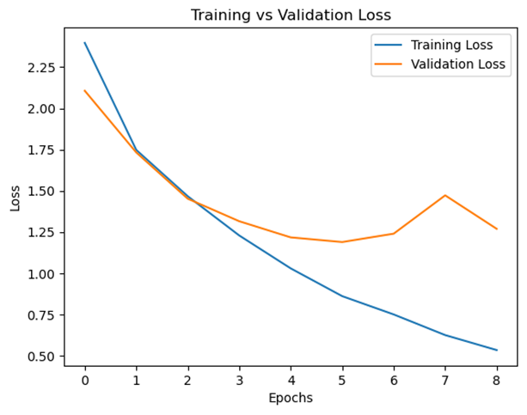
MODEL SUMMARY

Slide 30
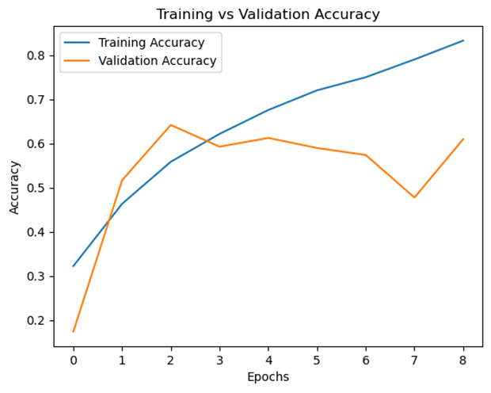
MODEL SUMMARY

Slide 31
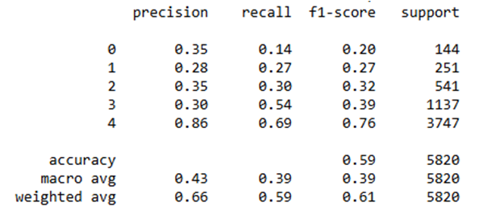
MODEL SUMMARY

Slide 32
MODEL ANALYSIS
  Overall Metrics
    Did not achieve 80% accuracy or higher.
    59% accuracy
    Classes 4 and 5 skewed.
    F1 score: 39%
  Implications
    Class imbalance.
    Fails to classify lower ratings accurately even after applying class weights.
  Limitations
    Class imbalance
    Overfitting
    Limited Scope

Slide 33
NEXT STEPS
  Next Approaches
    Research ways to work around class imbalance problem.
    Use more reviews.
    Create a more complex model with added layers.
  Business Approach
    Use this as a foundation for a flagger system.
    Find ways to market what is performing well.
    Find common trends for visitor complaints.

Slide 34
Thank you!
David Fabian
M.S. Data Analytics
Western Governors University

